Slide 1
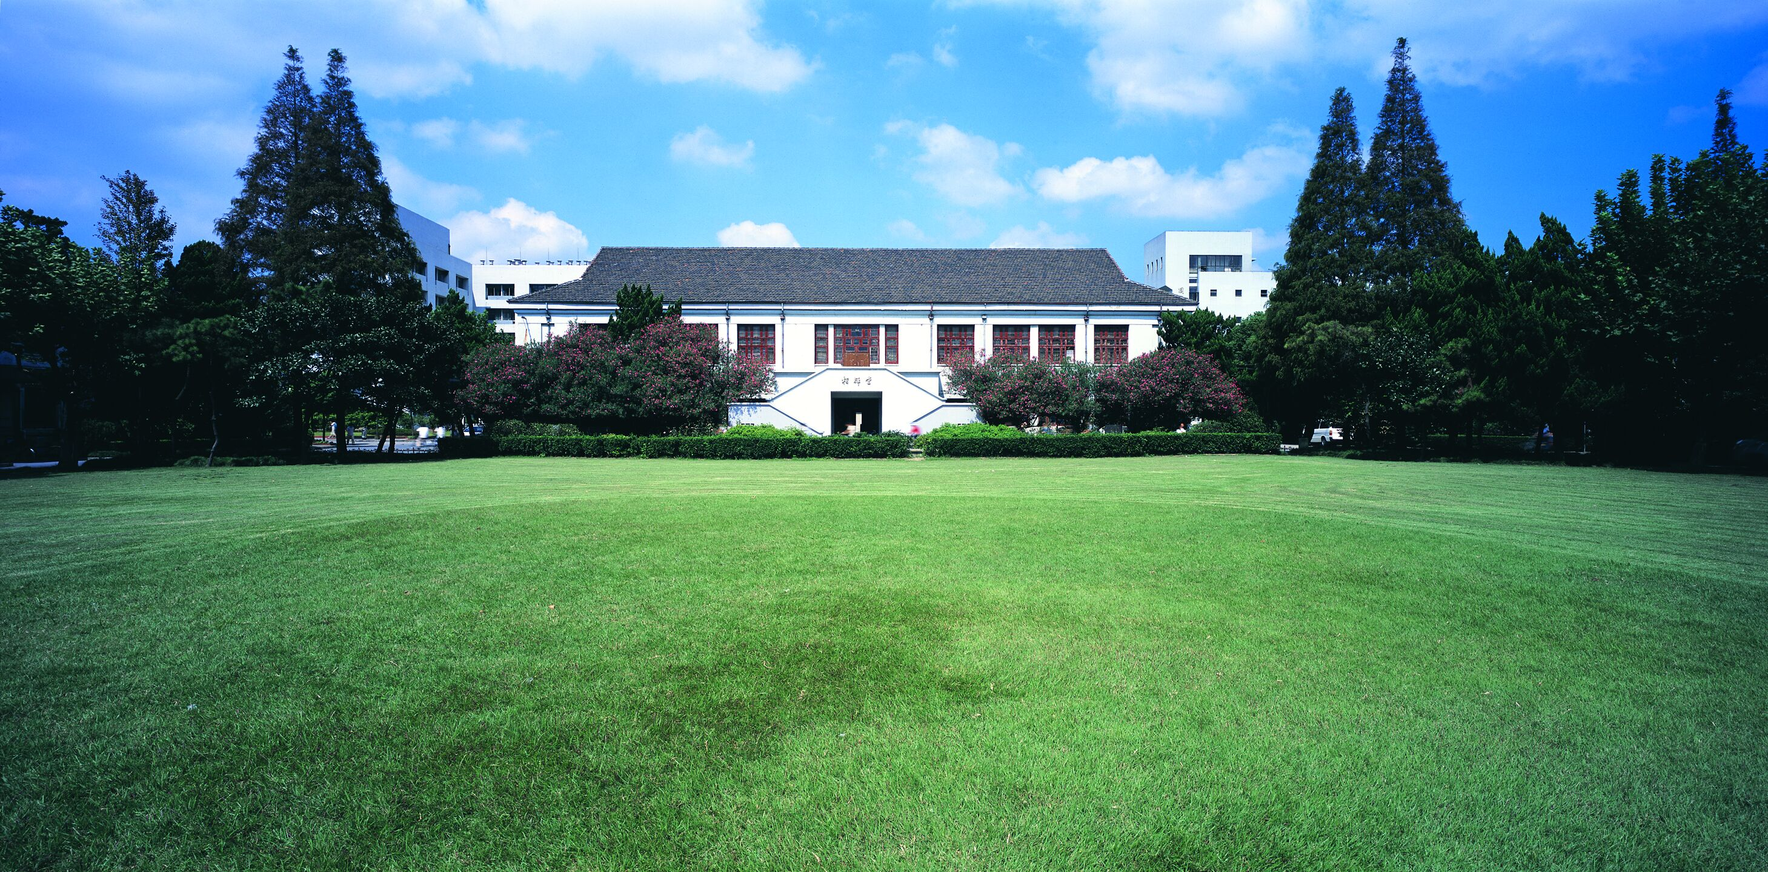
A Brief Introduction of CUDA Programming
赵梓豪 2020.01.09
Notes:
1

Slide 2
Outline
Statement of the logical architecture and main points
Background
CUDA Programming Model
GPU Architecture
Examples
Matrix Addition
Reduction
NMS

Slide 3

1
Background

Slide 4

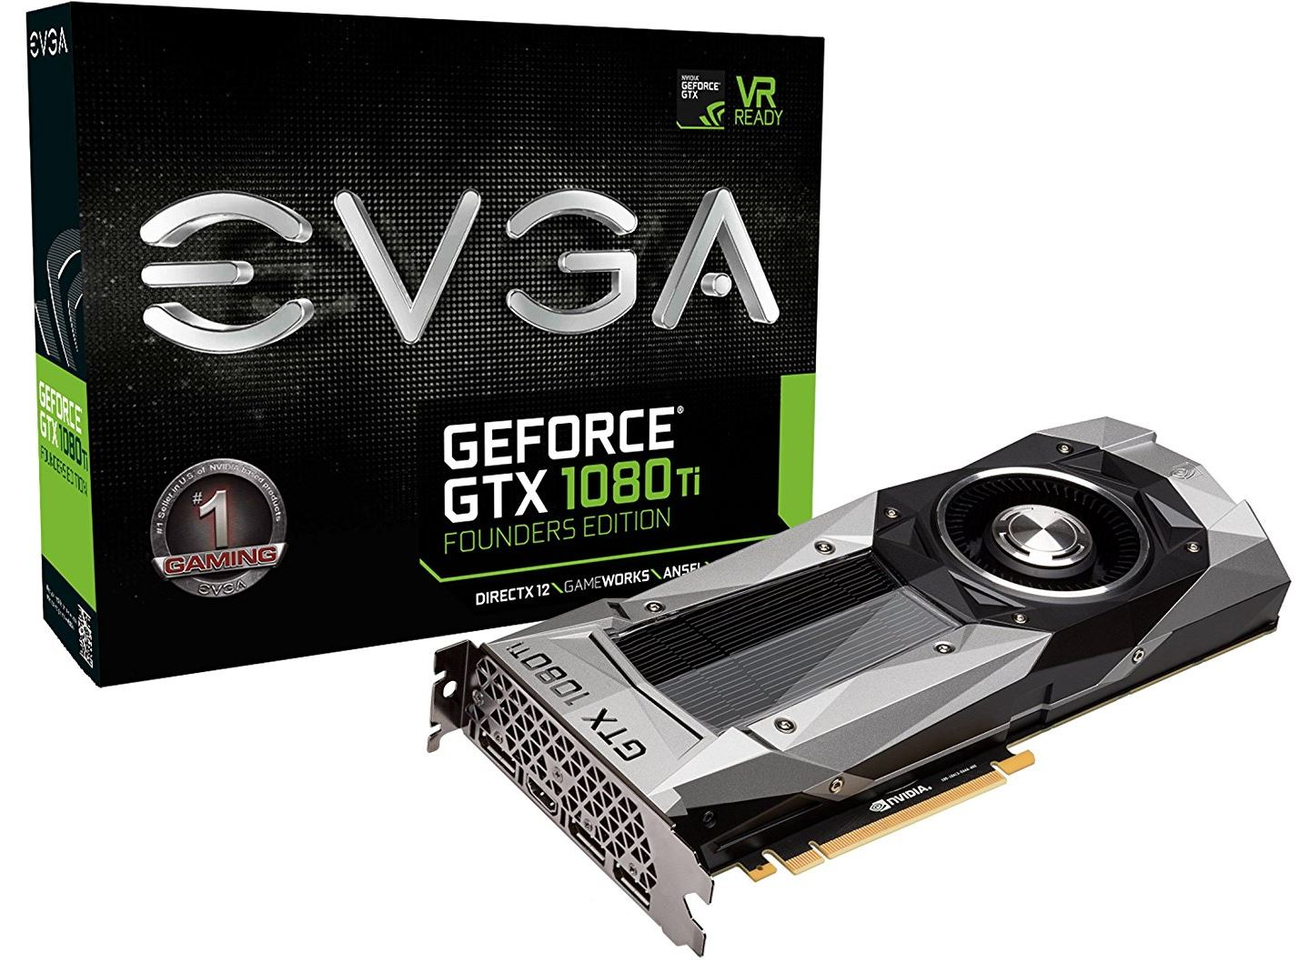

1.1 Why CUDA?
GPU is now the most widely used parallel computing device.
Very major deep learning framework such as Caffe2, Pytorch and TensorFlow rely on CUDA to deliver high-performance accelerated training.

Slide 5
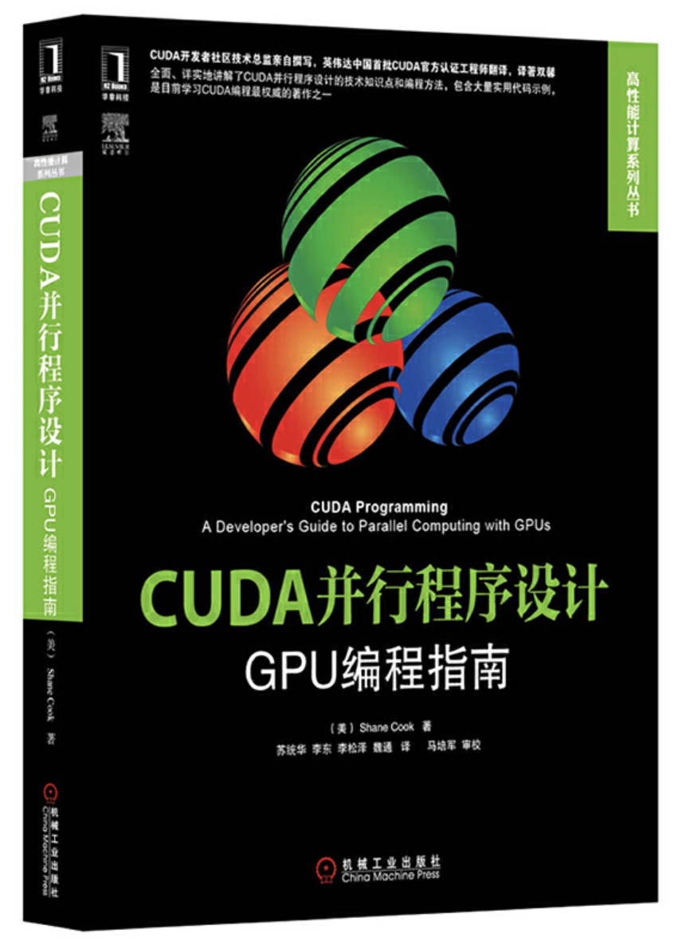
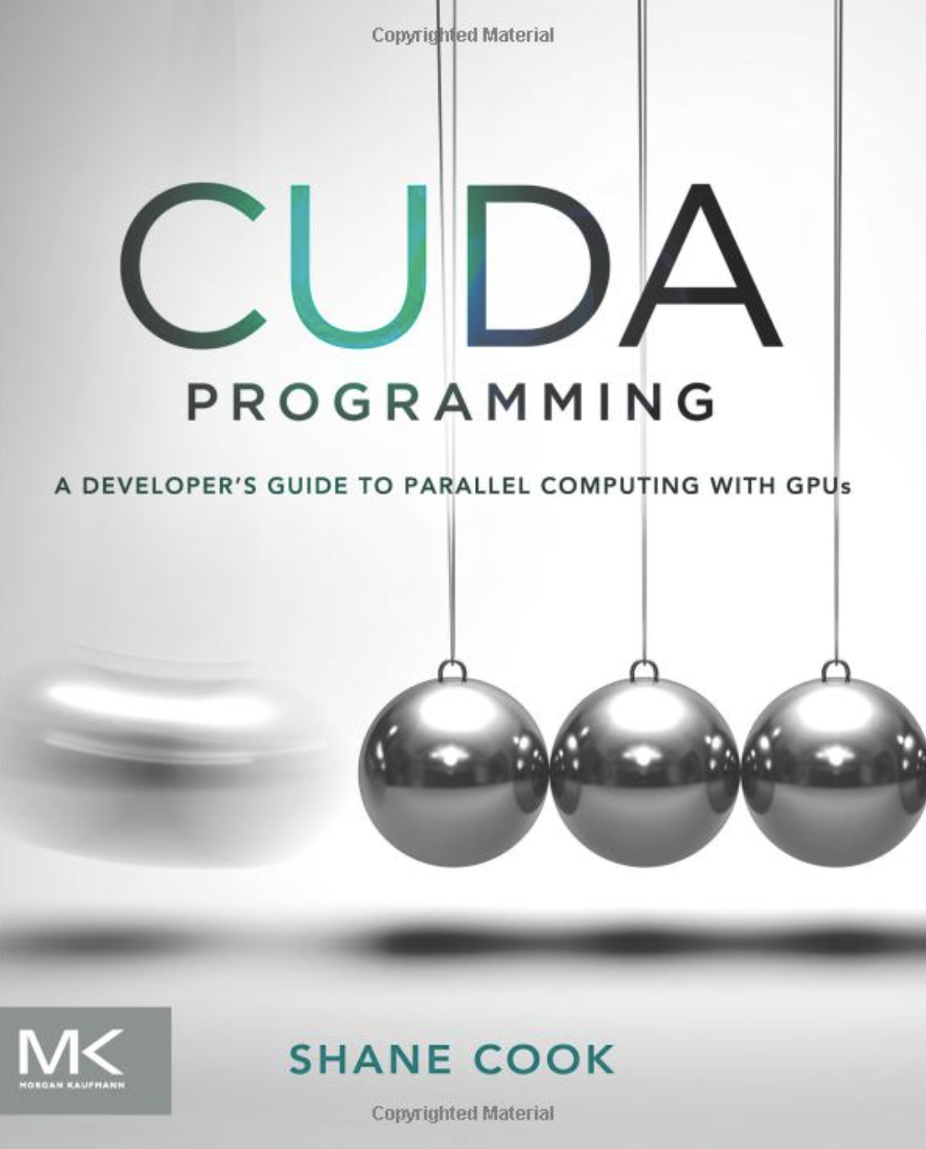
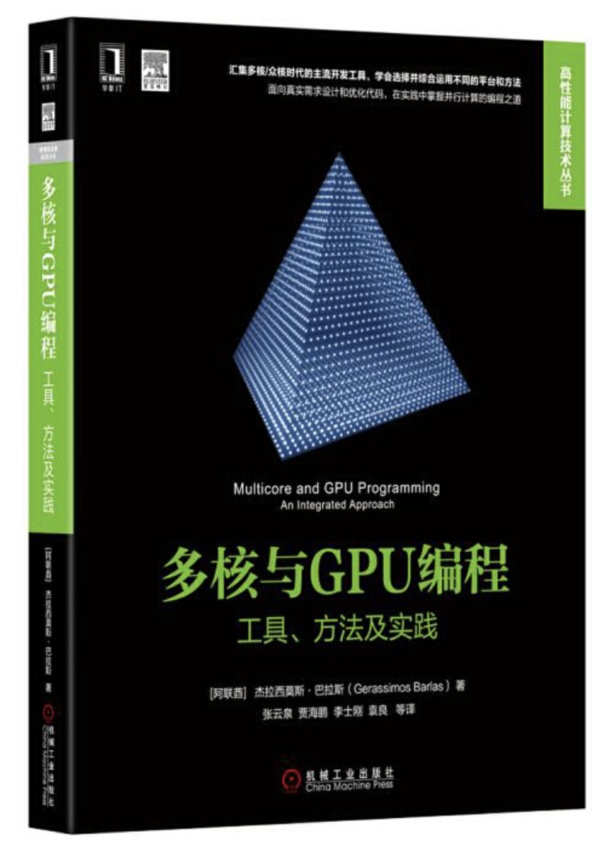
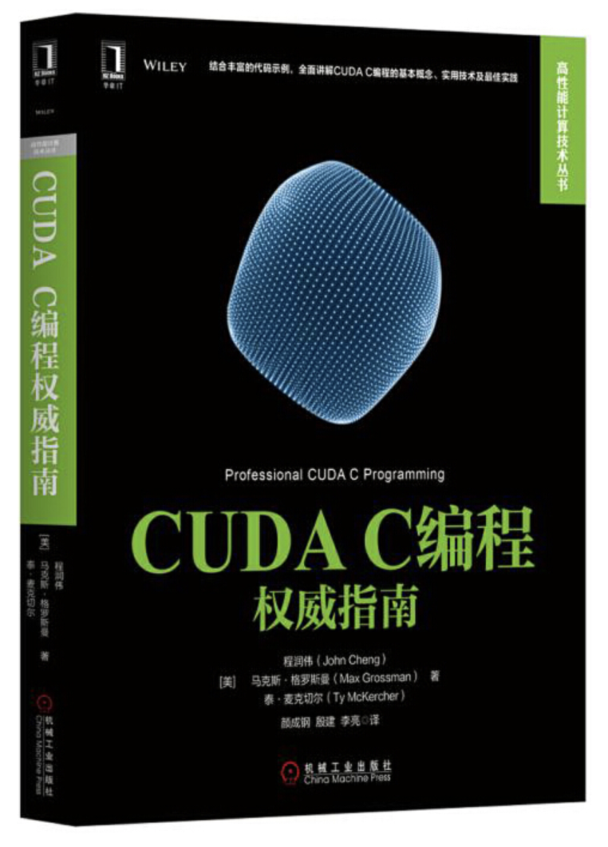
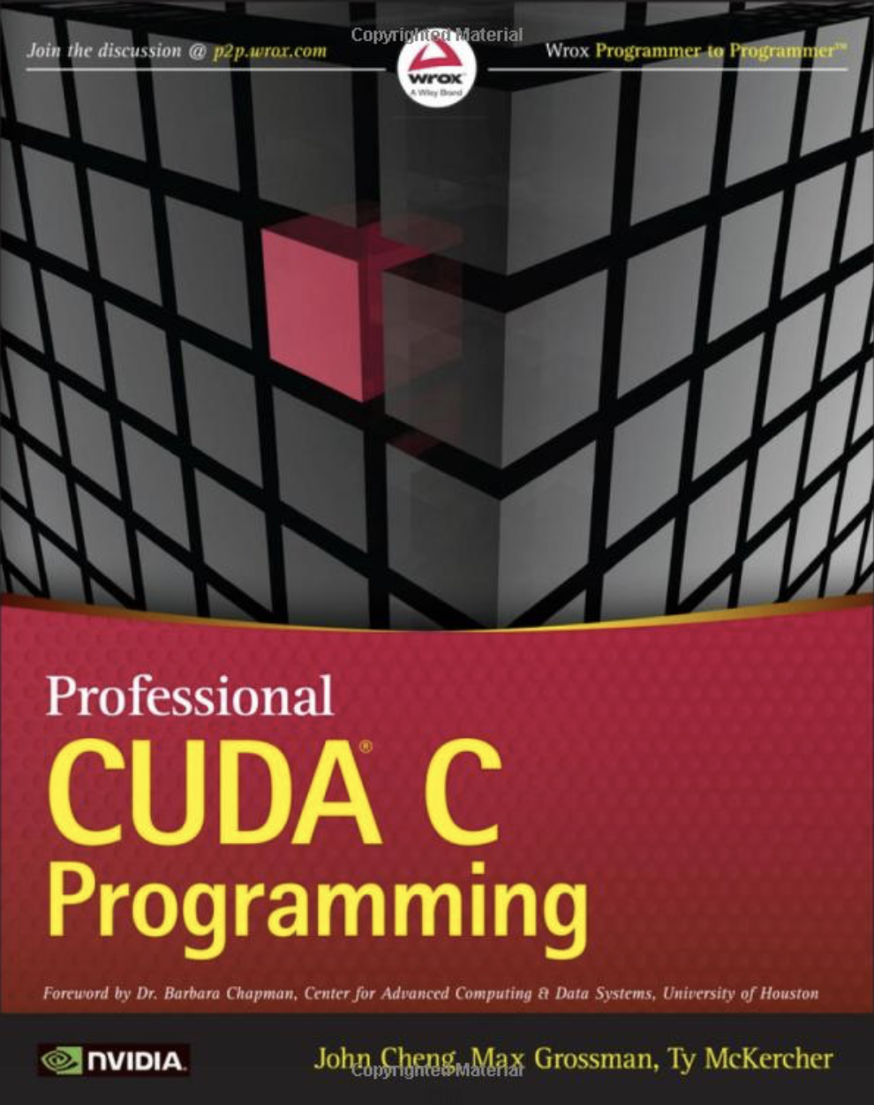
1.2 Reference
CUDA并行程序设计——GPU编程指南
CUDA C编程权威指南
多核与GPU编程——工具、方法及实现
CUDA programming: A developer's guide to parallel computing with GPUs
Professional CUDA C Programming
﻿NVIDIA Turing GPU Architecture

Slide 6
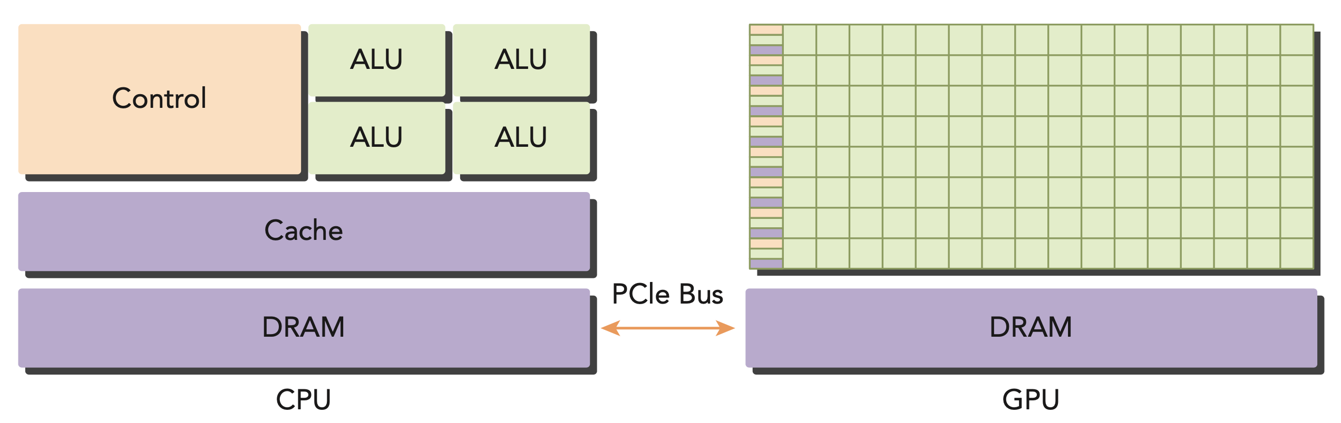
1.3 What is CUDA?
CUDA is a Parallel Computing platform and programming model with a small set of extensions to the C language.
CUDA is a platform for Heterogeneous Computing.

Slide 7
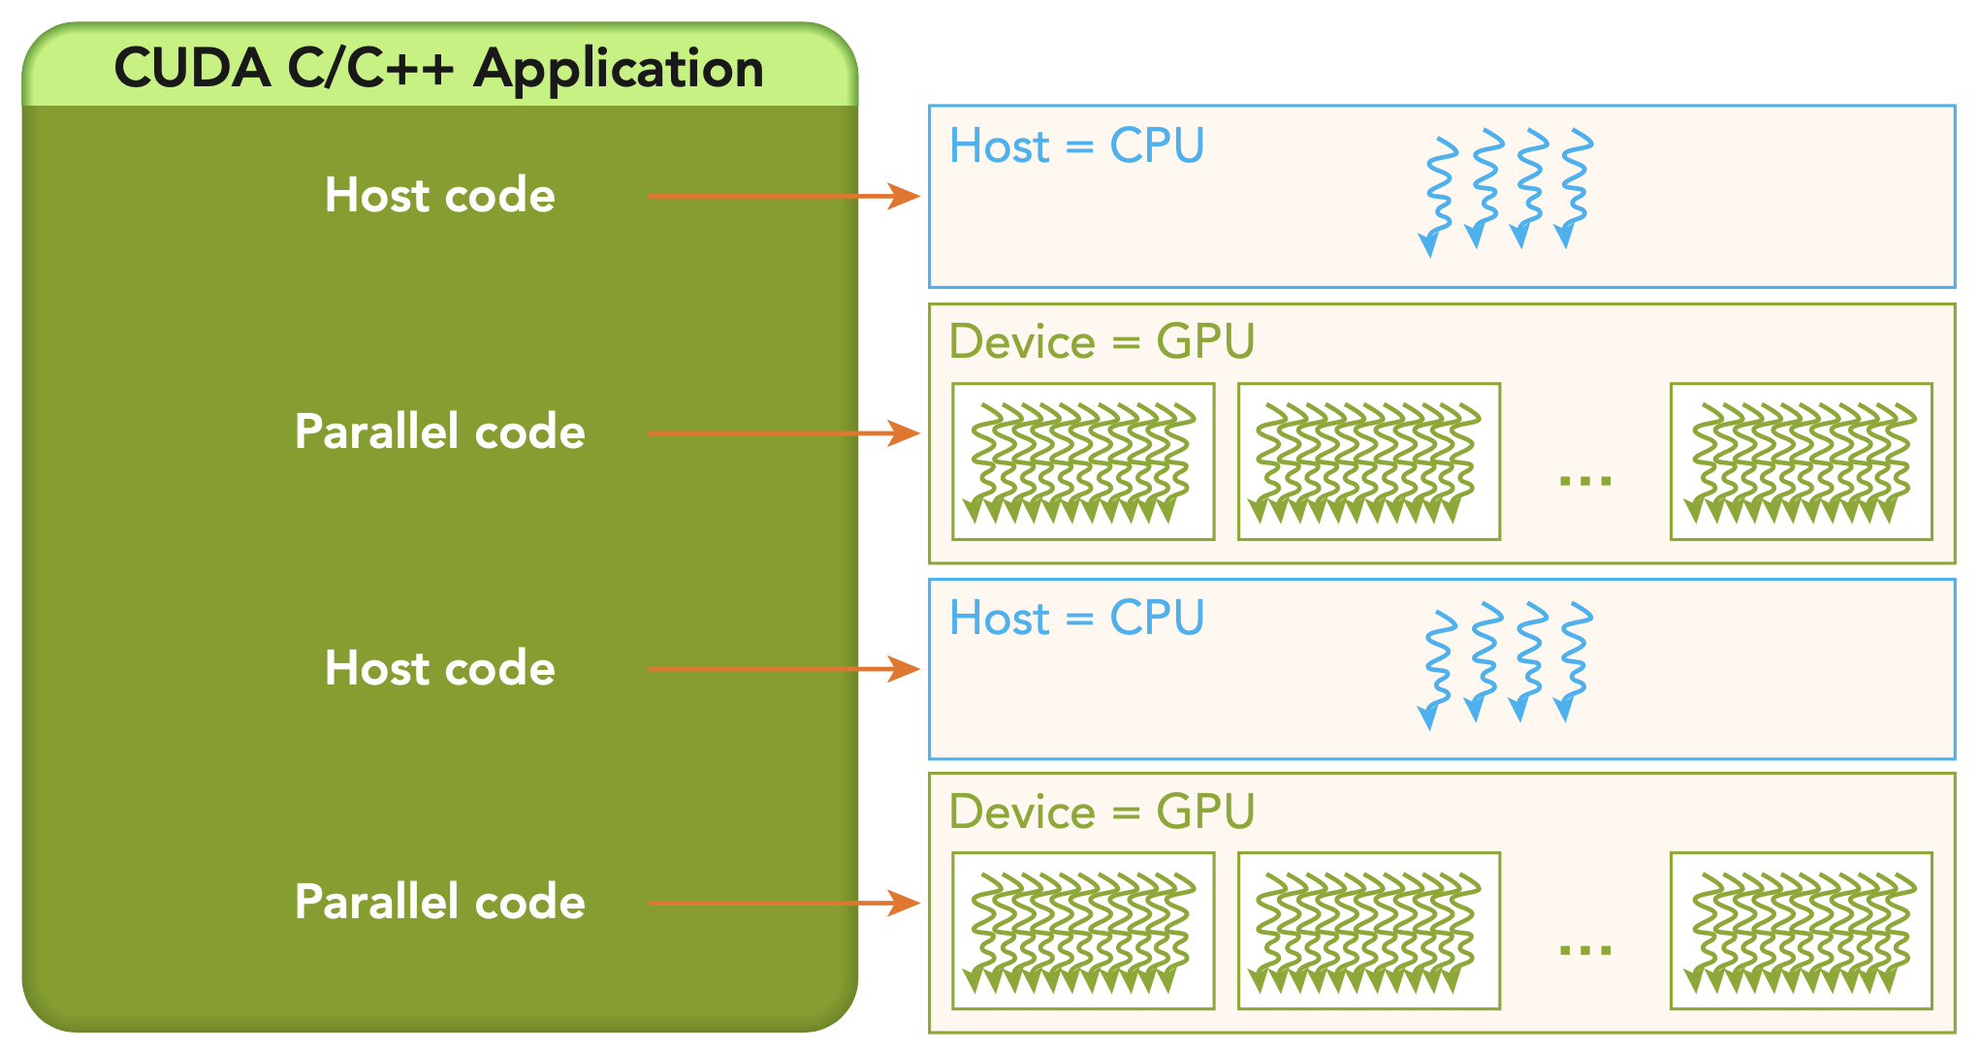
1.3 Parallel Heterogeneous Computing
Host: the CPU and its memory (host memory)
Device: the GPU and its memory (device memory)

Slide 8
2
CUDA Programming Model

Slide 9
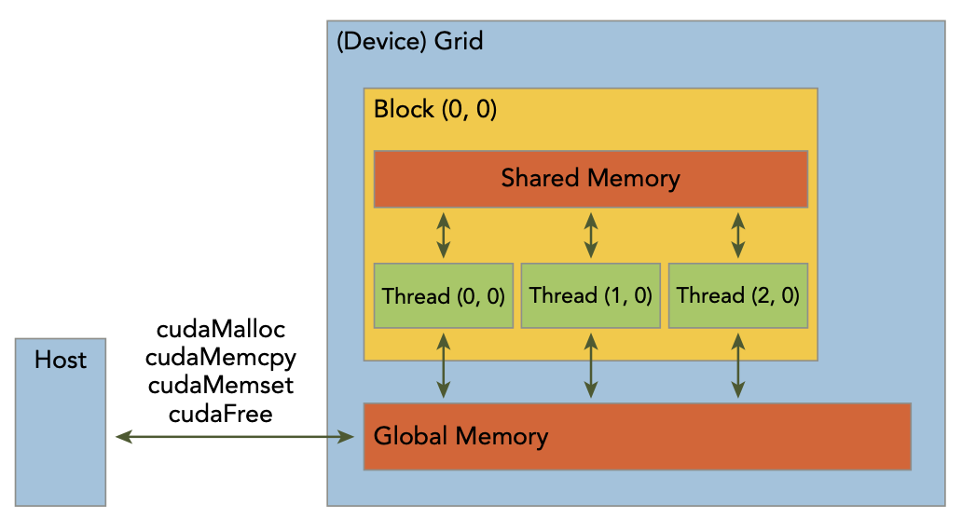
2.1 CUDA Programming Model
The CUDA programming model provides the following special features to harness the computing power of GPU architectures.
A way to organize threads on the GPU through a hierarchy structure
A way to access memory on the GPU through a hierarchy structure
Host: the CPU and its memory (host memory)
Device: the GPU and its memory (device memory)

Slide 10
2.1 CUDA Programming Structure
A typical processing flow of a CUDA program follows this pattern:
Copy data from CPU memory to GPU memory.
Invoke kernels to operate on the data stored in GPU memory.
Copy data back from GPU memory to CPU memory.
Organizing Threads
Accessing Memory
Host: the CPU and its memory (host memory)
Device: the GPU and its memory (device memory)

Slide 11
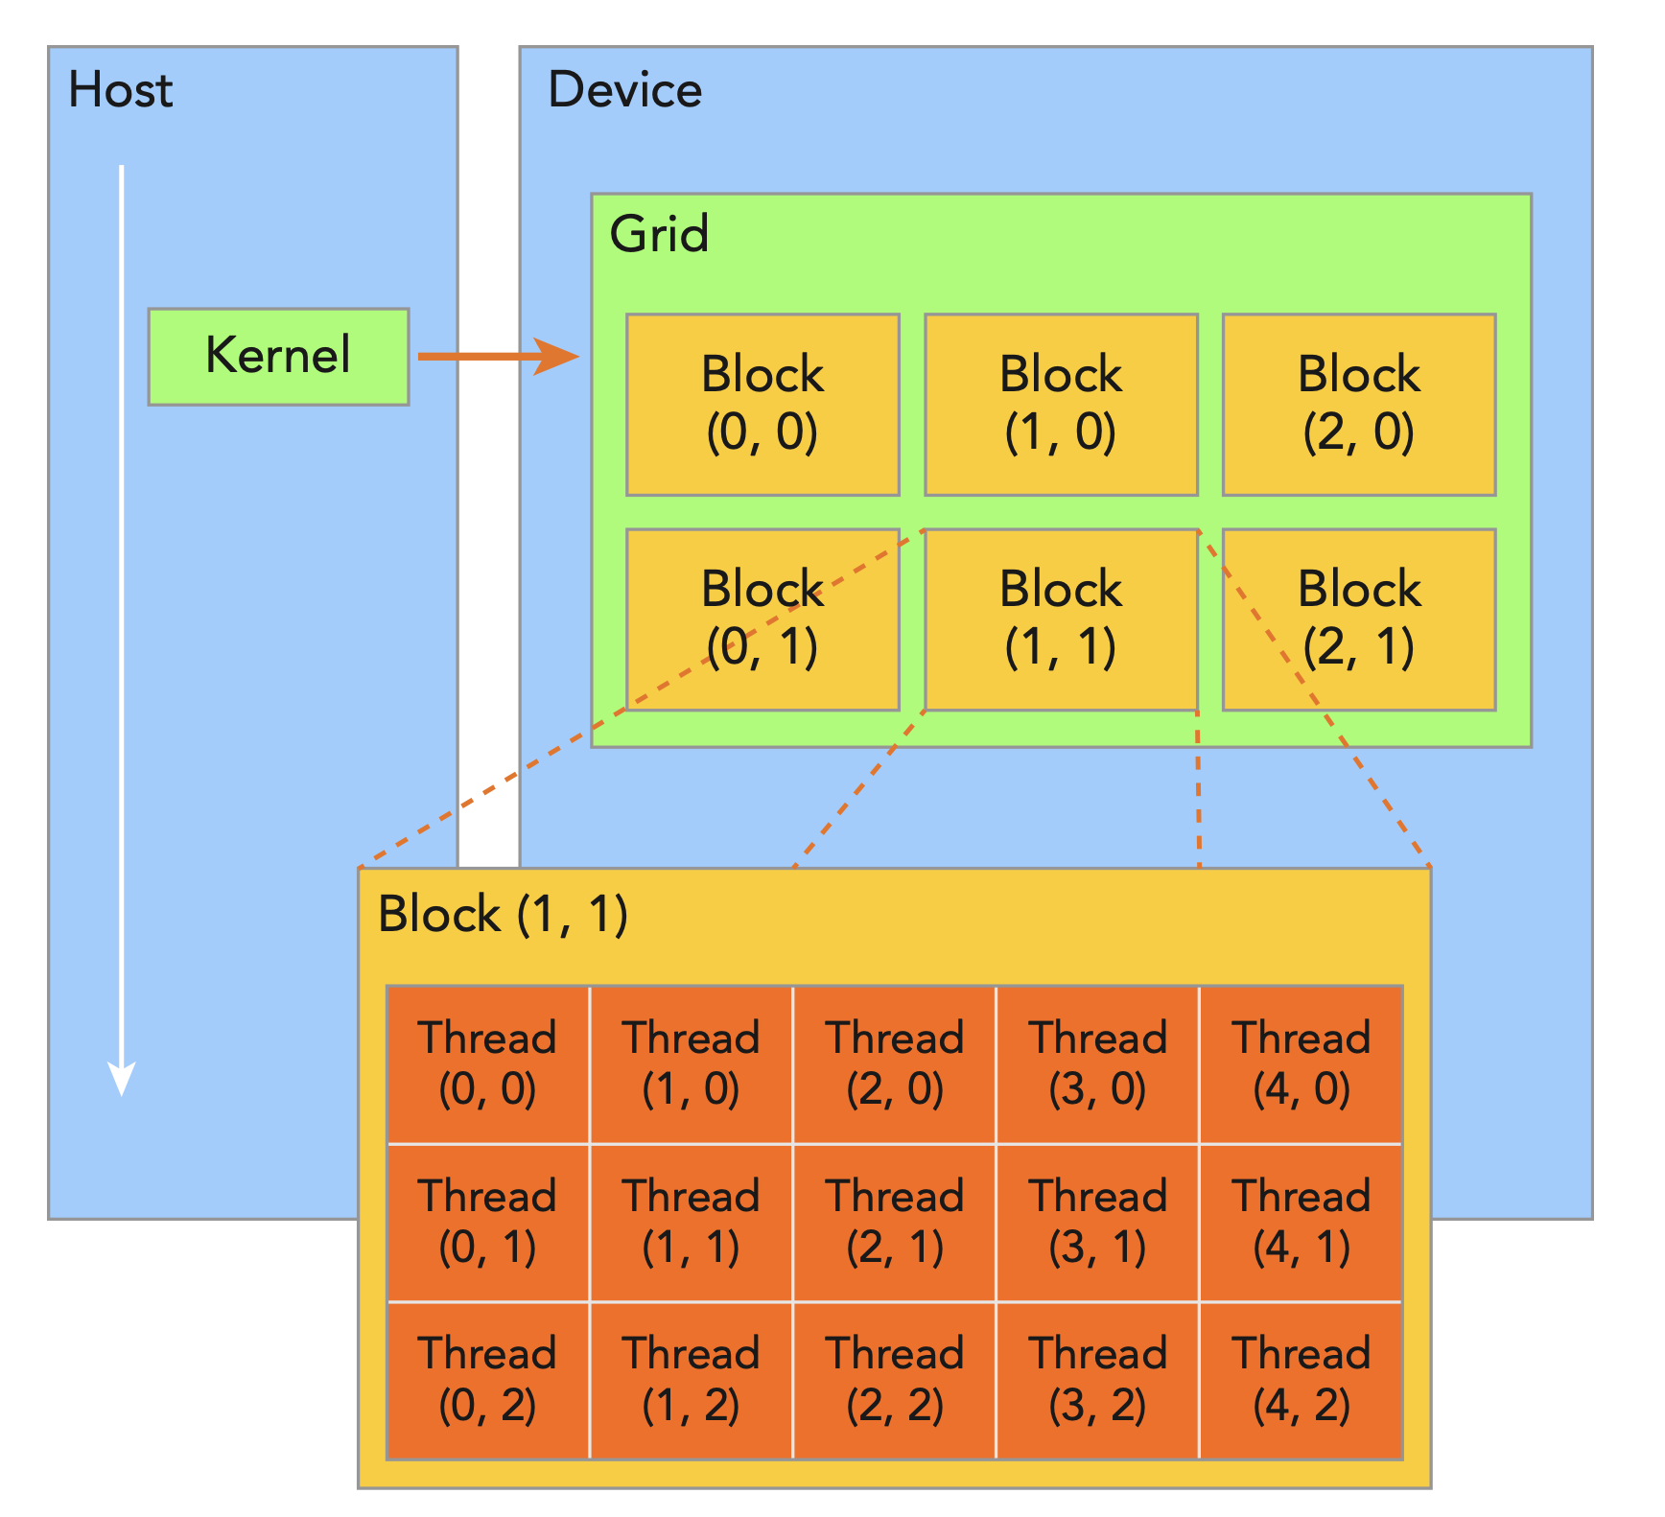
2.2 Organizing Threads
When a kernel function is launched from the host side, execution is moved to a device where a large number of threads are generated and each thread executes the statements specified by the kernel function.
Single Instruction Multiple Thread (SIMT)
Host: the CPU and its memory (host memory)
Device: the GPU and its memory (device memory)

Slide 12
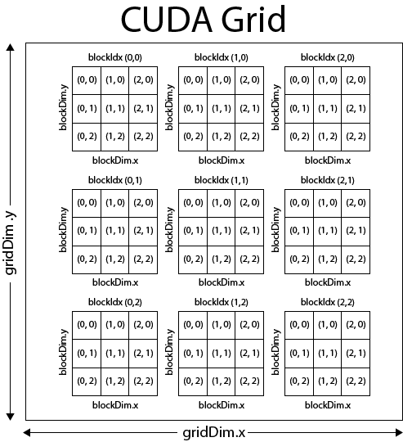
2.2 Organizing Threads
All threads spawned by a single kernel launch are collectively called a grid. A grid is made up of many thread blocks.

Slide 13
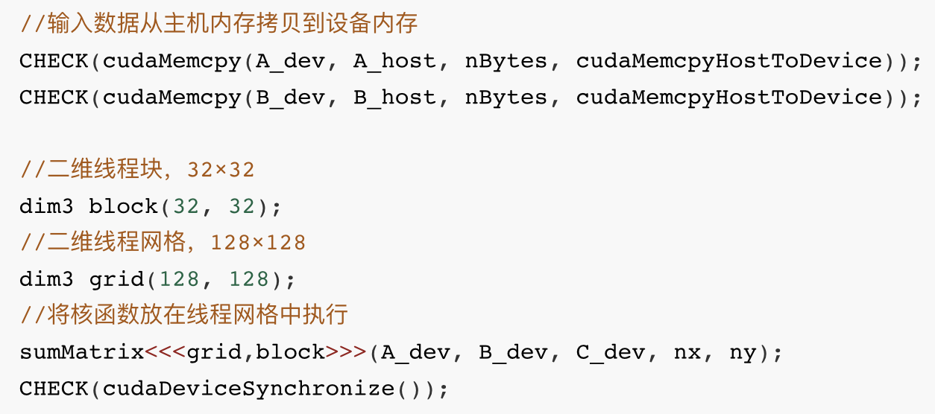
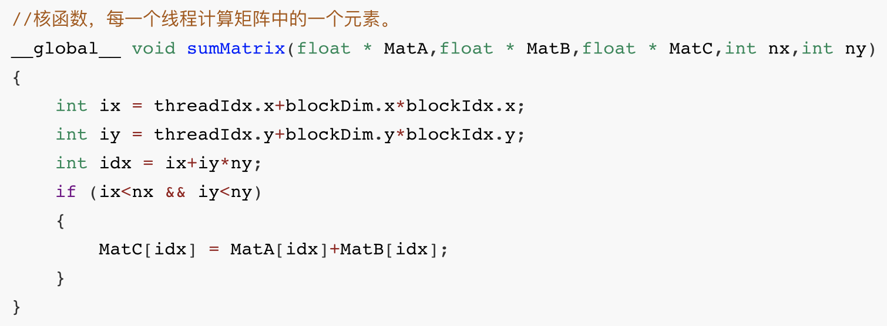
2.2 Organizing Threads

Slide 14
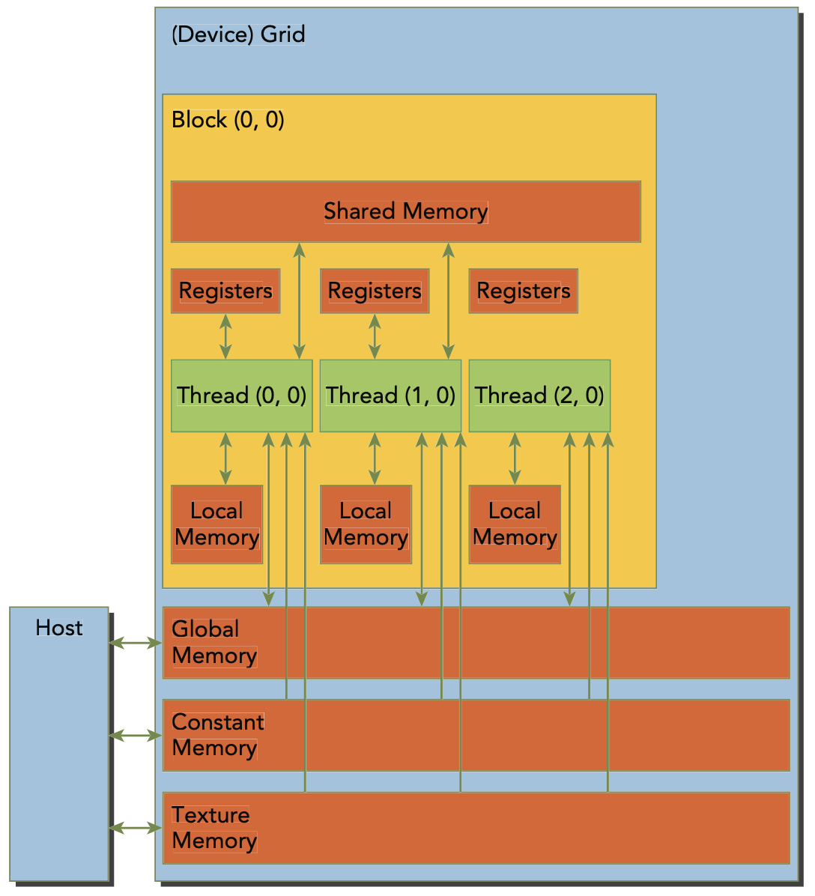
2.3 Accessing Memory
CPU vs. GPU
Registers
Shared Memory
Global Memory
Constant Memory
Local Memory
Texture Memory
On Chip
Off Chip

Slide 15
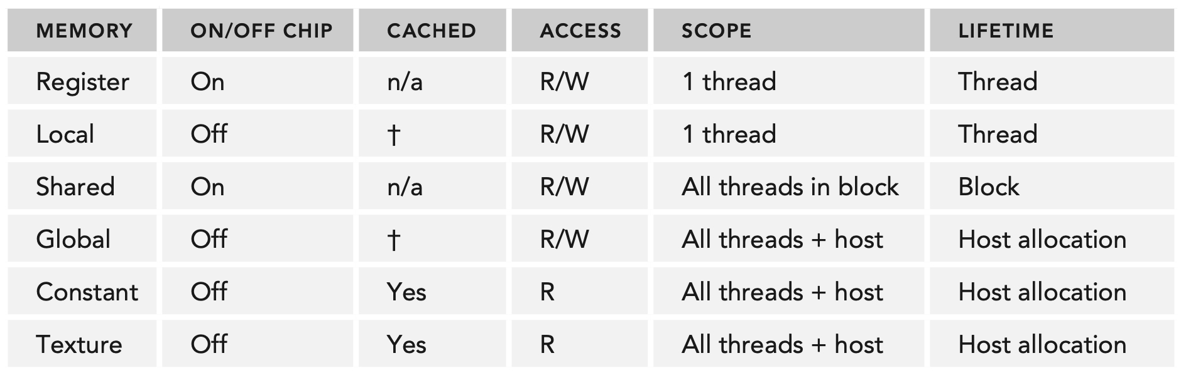
2.3 Accessing Memory
Registers are the fastest memory space on a GPU.
Shared memory serves as a basic means for inter-thread communication.
Global memory is the largest, highest-latency, and most commonly used memory on a GPU.

Slide 16
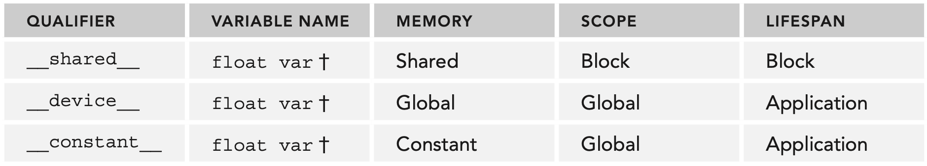
2.3 Accessing Memory
CUDA Variable and Type Qualifier
Memory Allocation and Deallocation

Slide 17
2.2 Organizing Threads
All threads spawned by a single kernel launch are collectively called a grid. A grid is made up of many thread blocks.
All threads in a grid share the same global memory space. A thread block is a group of threads that can cooperate with each other using:
Block-local synchronization
Block-local shared memory
Threads from different blocks cannot cooperate.

Slide 18
3
GPU Architecture

Slide 19
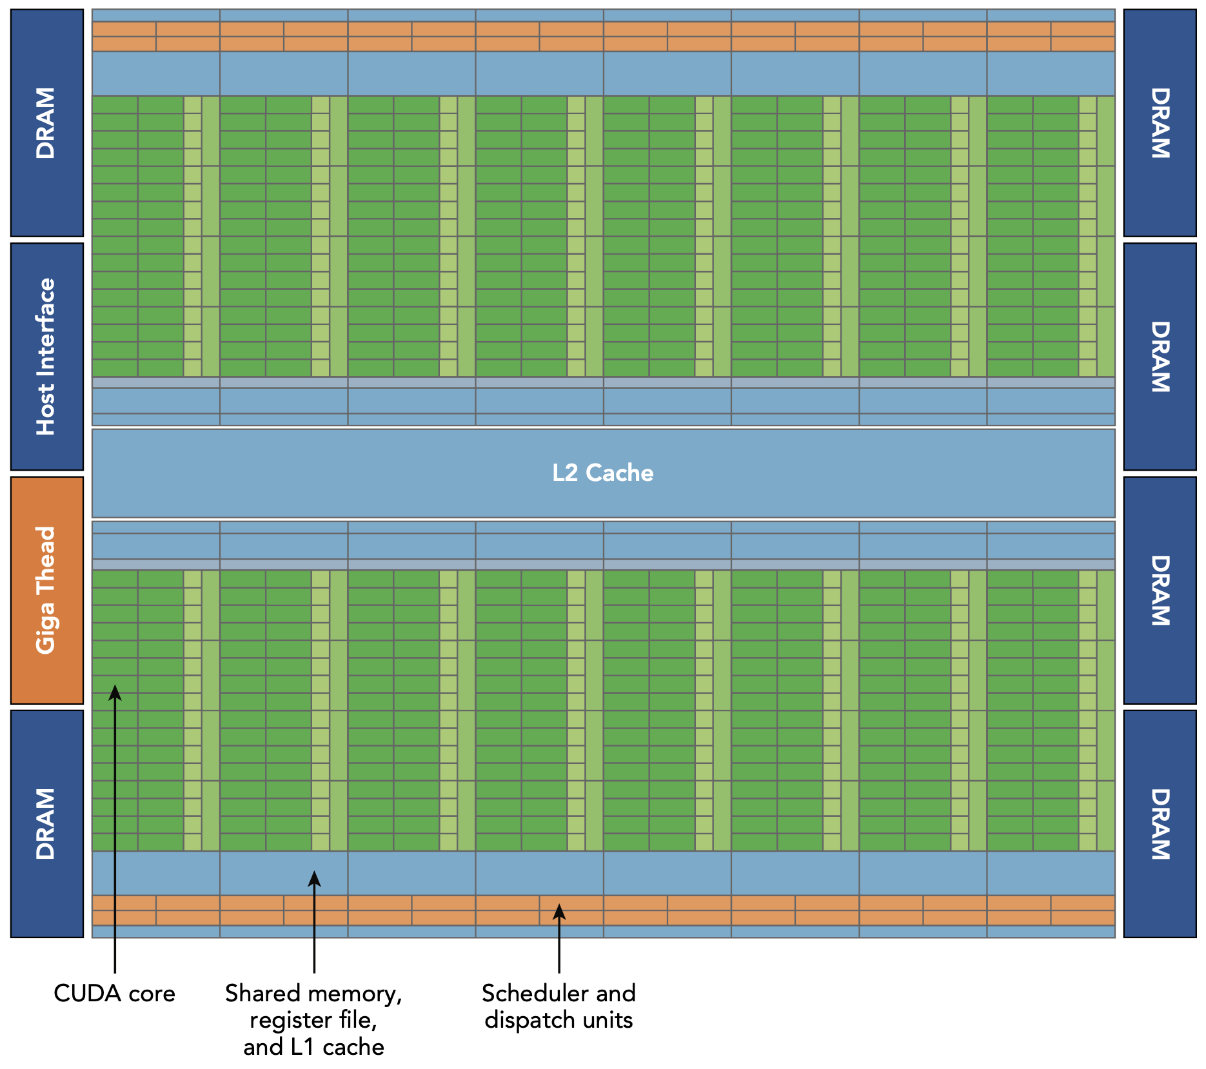
3.1 GPU Architecture Overview

Slide 20
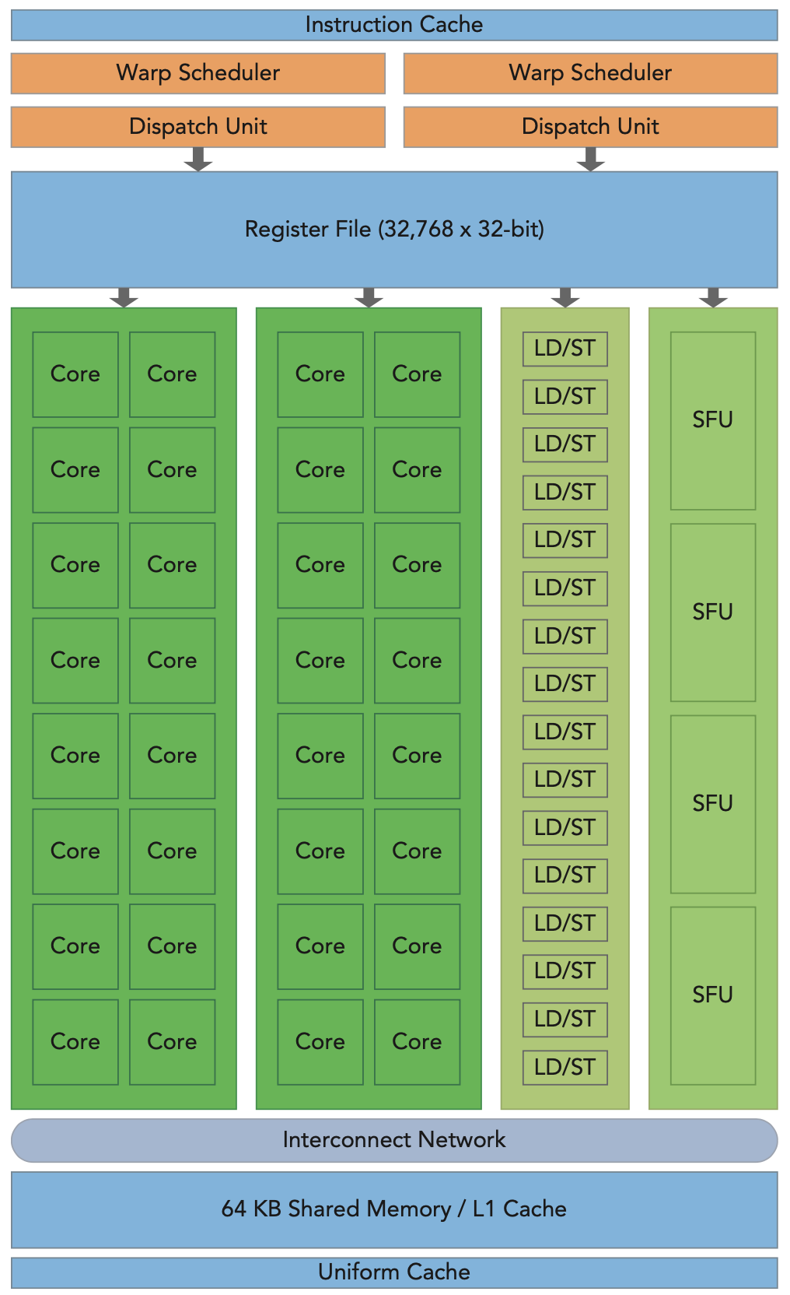
3.1 GPU Architecture Overview
The GPU architecture is built around a scalable array of Streaming Multiprocessors (SM). GPU hardware parallelism is achieved through the replication of this architectural building block.
Execution units (CUDA cores)
Scheduler and dispatcher units that schedule warps
Shared memory, the register file, and L1 cache

Slide 21
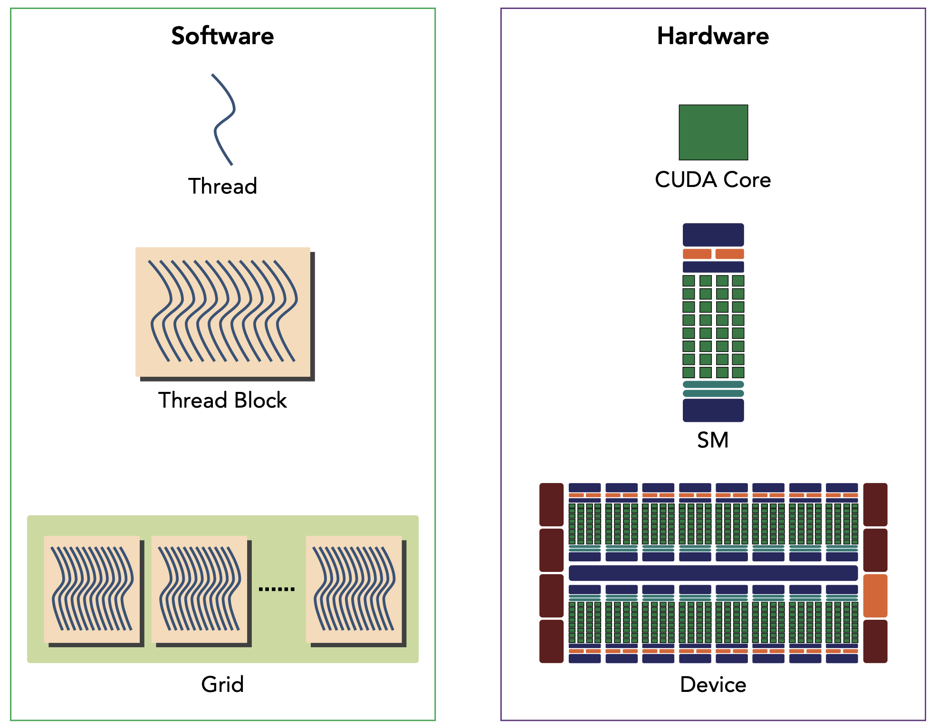
3.2 Logic View vs. Hardware View
A thread block is scheduled on only one SM.
Once a thread block is scheduled on an SM, it remains there until execution completes.
An SM can hold more than one thread block at the same time.
This figure illustrates the corresponding components from the logical view and hardware view of CUDA programming.

Slide 22
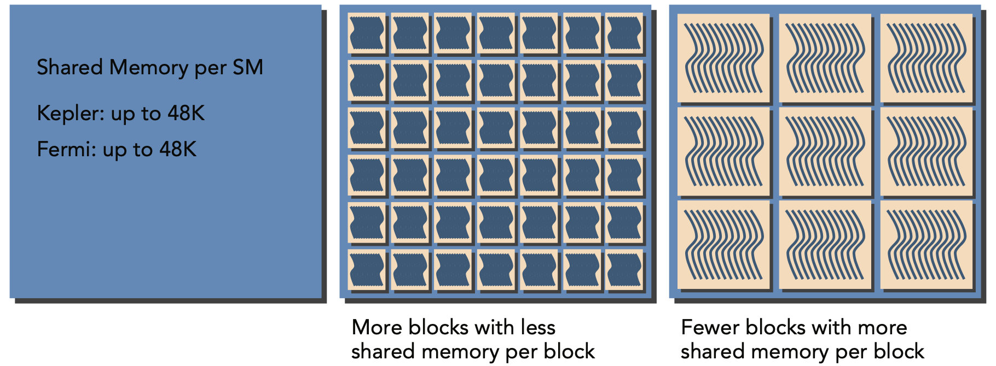
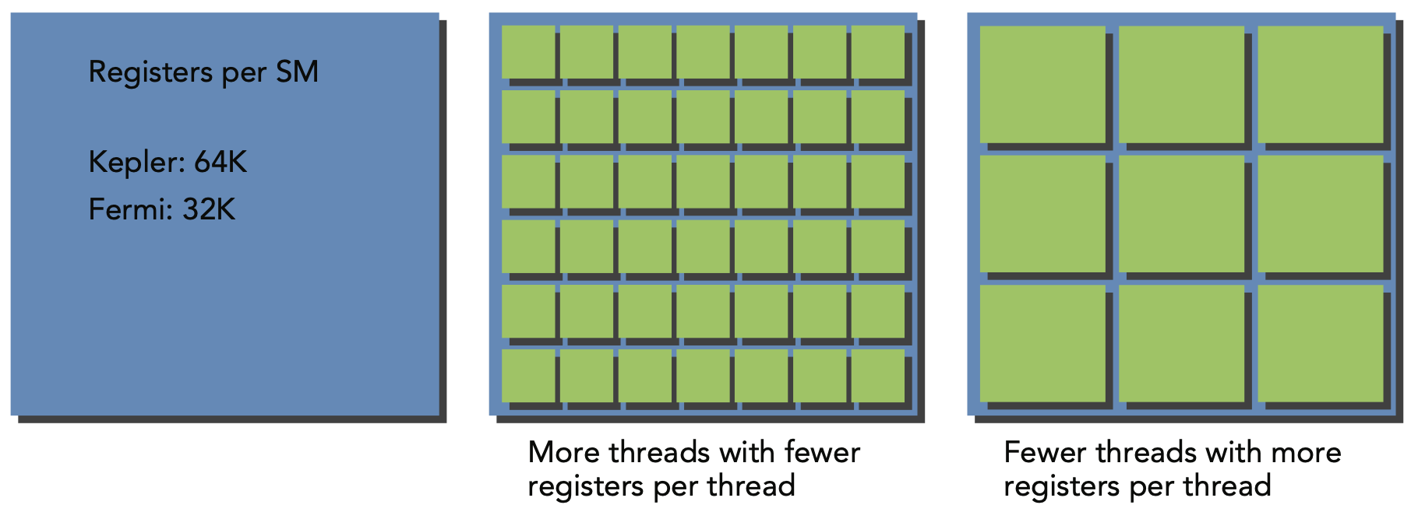
3.3 Resource Partitioning
The number of thread blocks and warps that can simultaneously reside on an SM for a given kernel depends on the number of registers and amount of shared memory available on the SM and required by the kernel.

Slide 23
4
Programming Examples

Slide 24
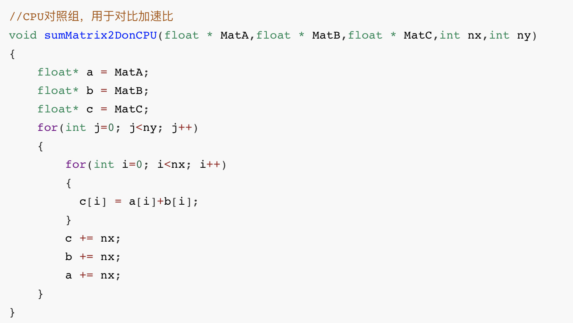
4.1 Matrix Addition
Matrix adding on CPU

Slide 25
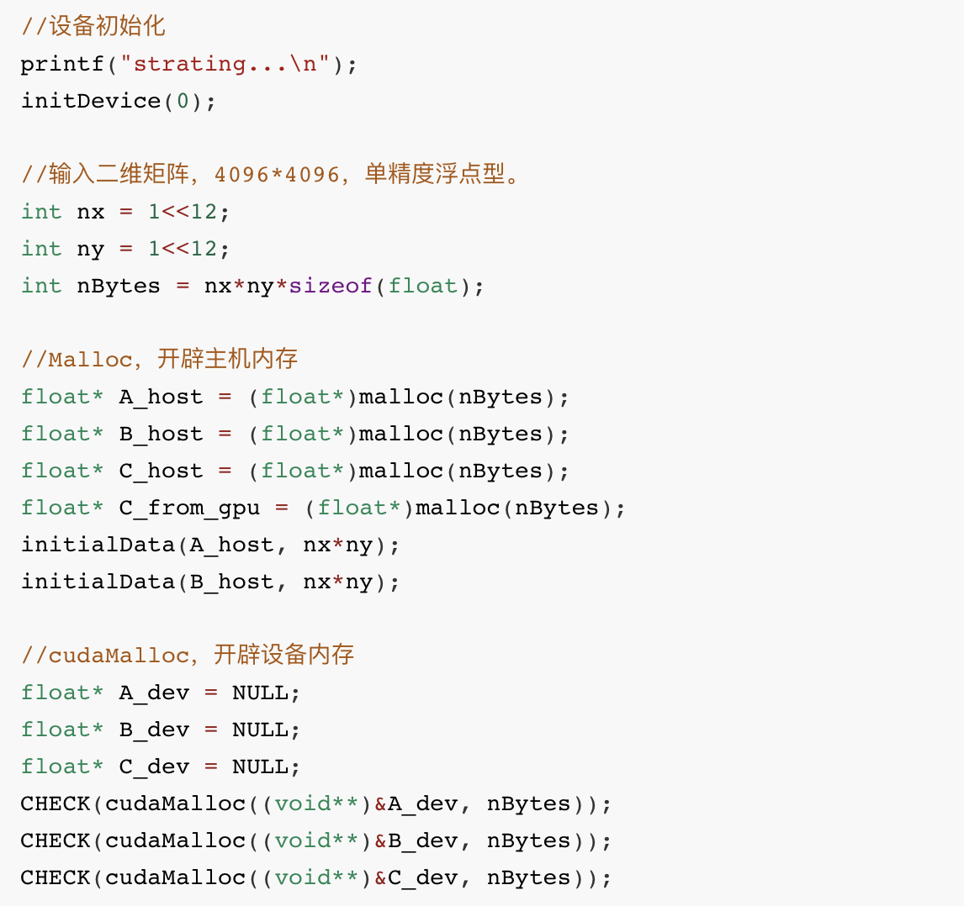
4.1 Matrix Addition
Main function

Slide 26
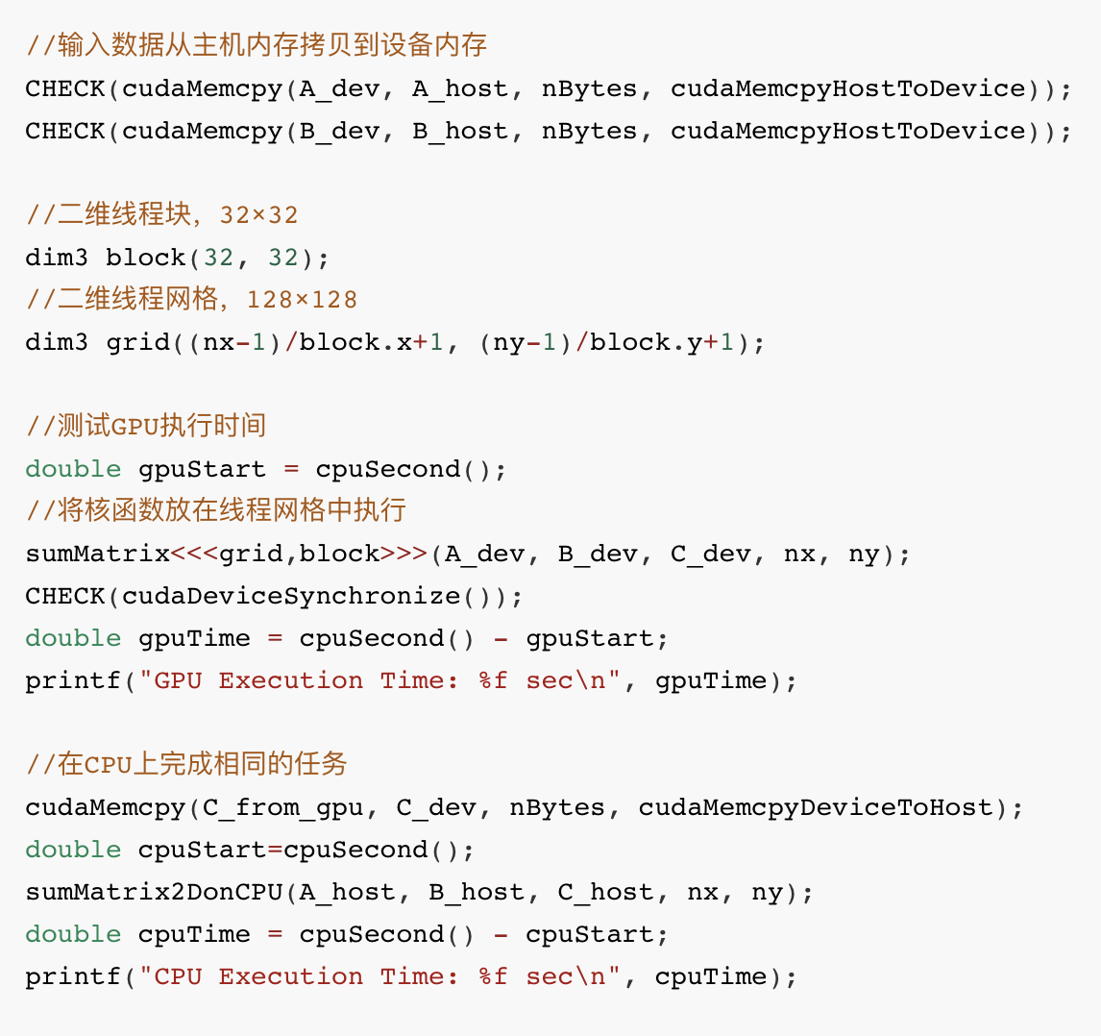
4.1 Matrix Addition
Main function

Slide 27
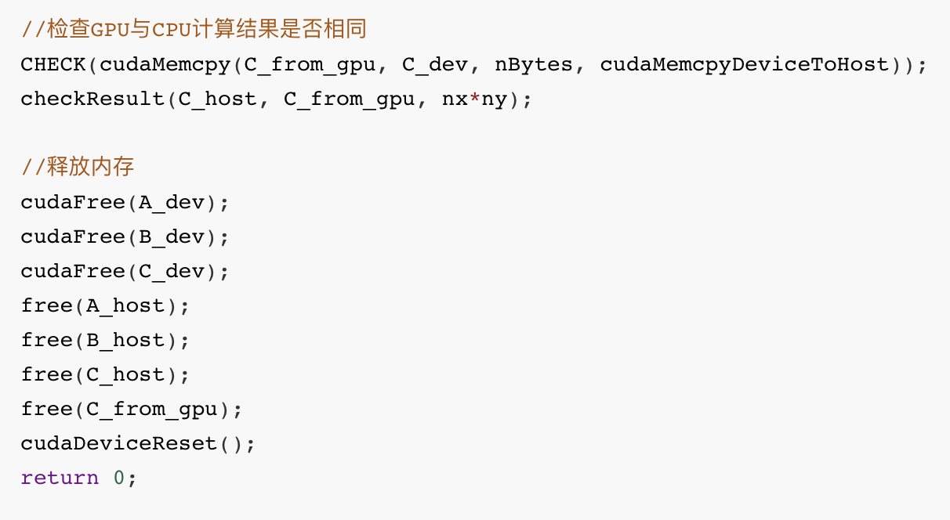
4.1 Matrix Addition
Main function

Slide 28
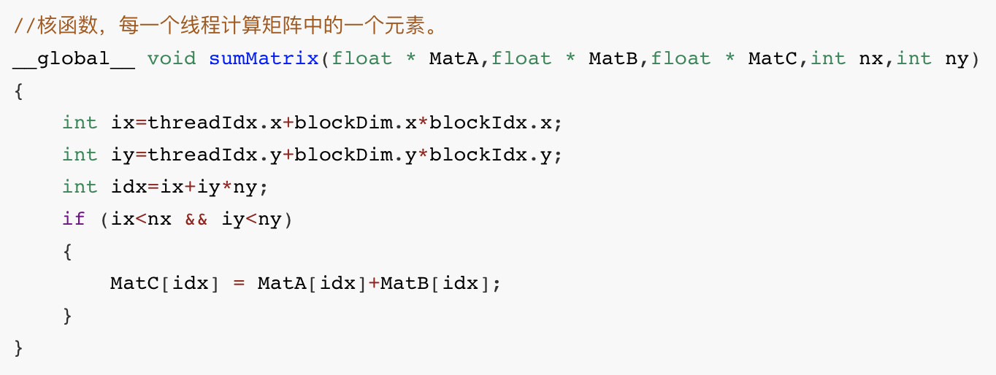
4.1 Matrix Addition
Kernel

Slide 29
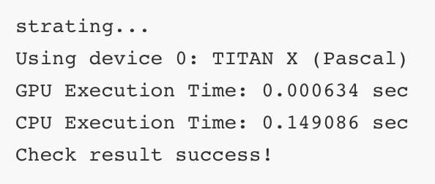
4.1 Matrix Addition
Result
Speedup 0.149086/0.000634=235 times

Slide 30
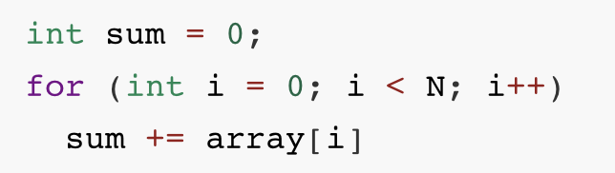
4.2 Parallel Reduction with CUDA(并行规约)
Suppose you want to calculate the sum of an array of integers with N elements.
It would be quite easy for you to implement the algorithm using sequential code as follows:

Slide 31
4.2 Parallel Reduction with CUDA
How to execute it in parallel?
Partition the input vector into smaller chunks.
Have a thread calculate the partial sum for each chunk.
Add the partial results from each chunk into a final sum.

Slide 32
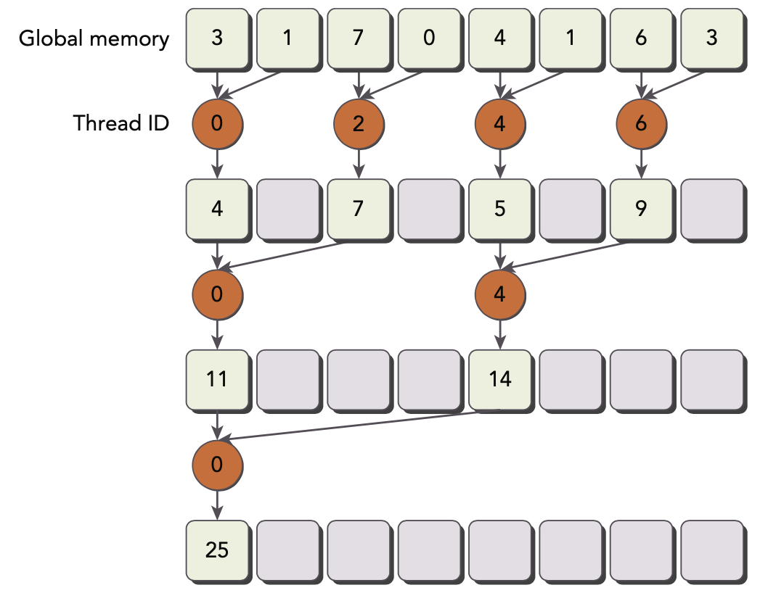
4.2 Parallel Reduction with CUDA

Slide 33
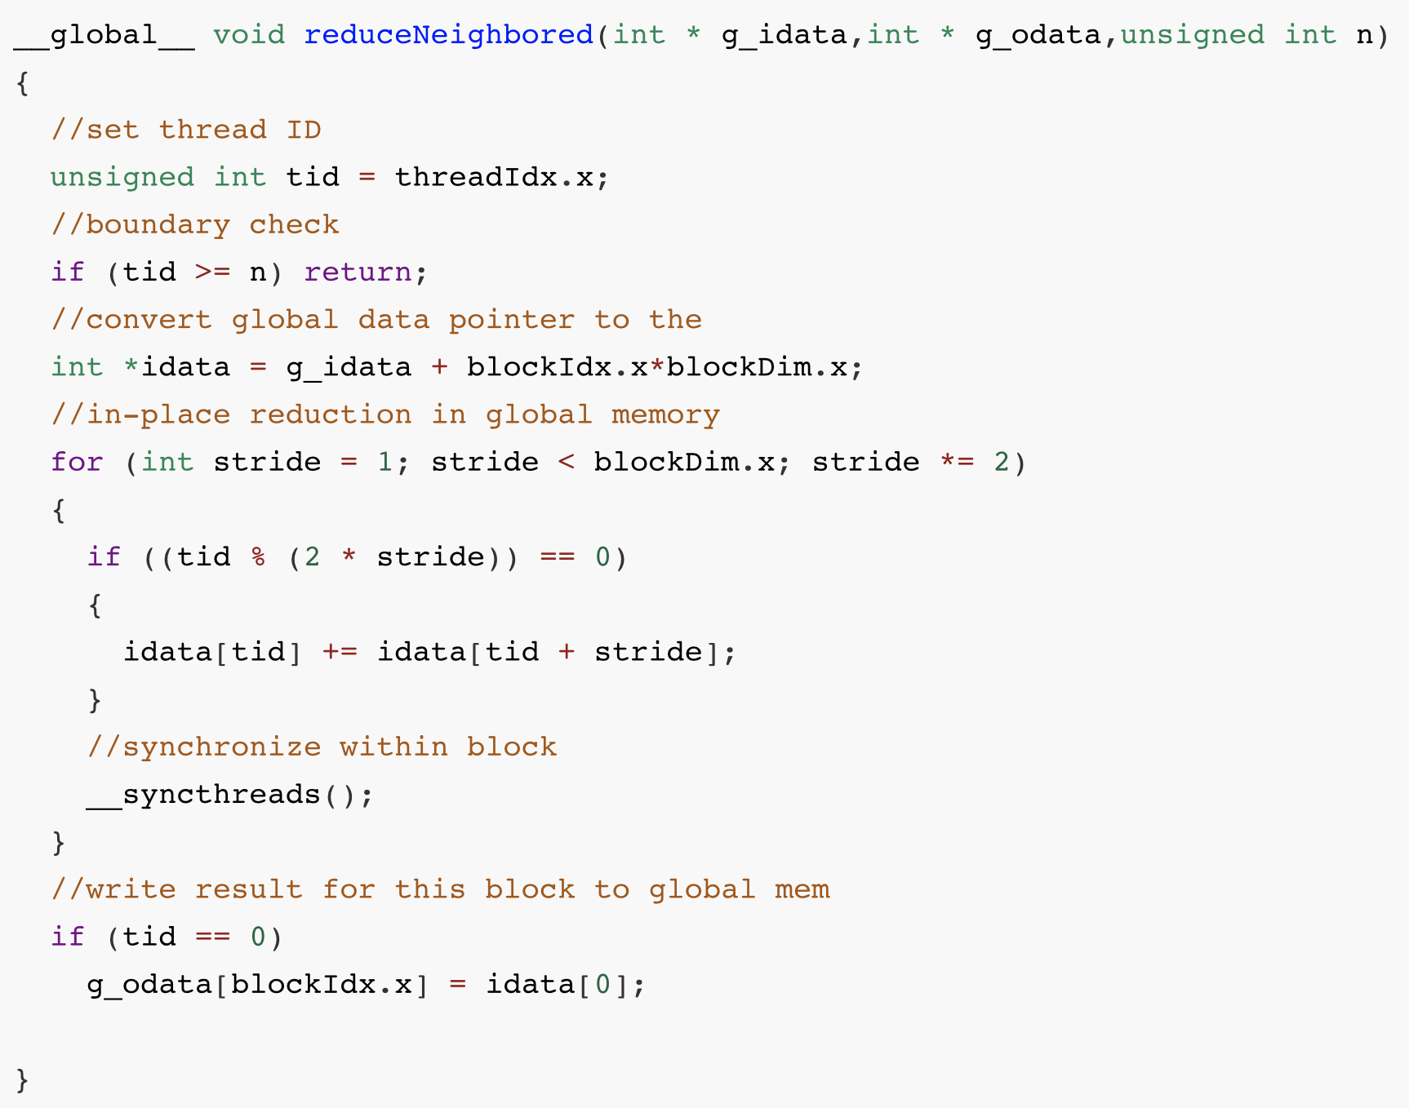
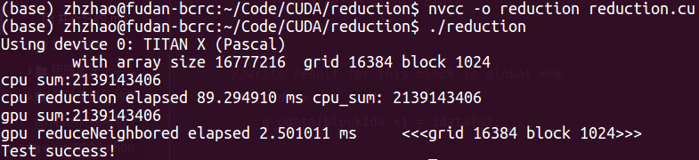
4.2 Parallel Reduction with CUDA

Slide 34
4.2 Parallel Reduction with CUDA
Warp Divergence!

Slide 35
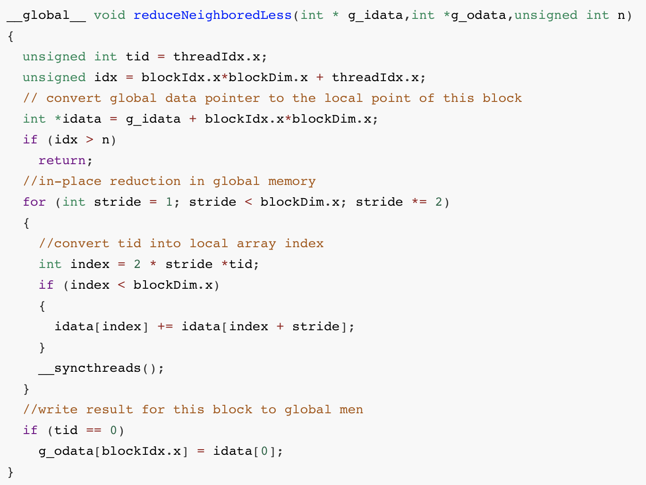
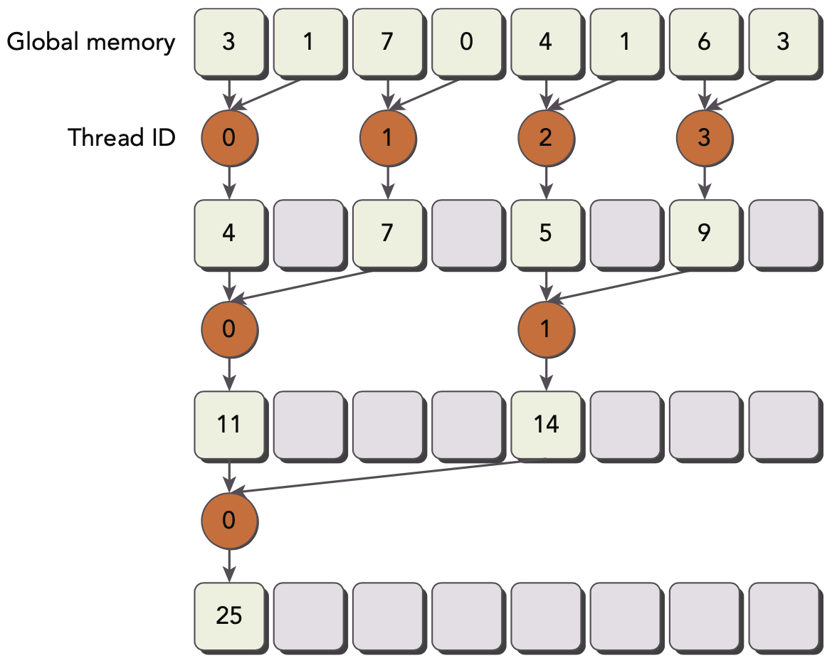
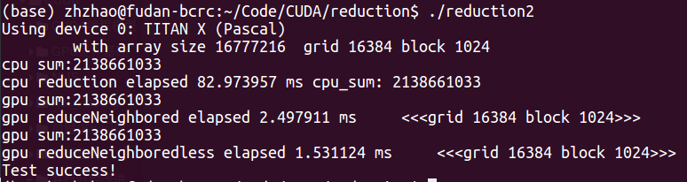
4.2 Parallel Reduction with CUDA

Slide 36
4.2 Parallel Reduction with CUDA

Slide 37
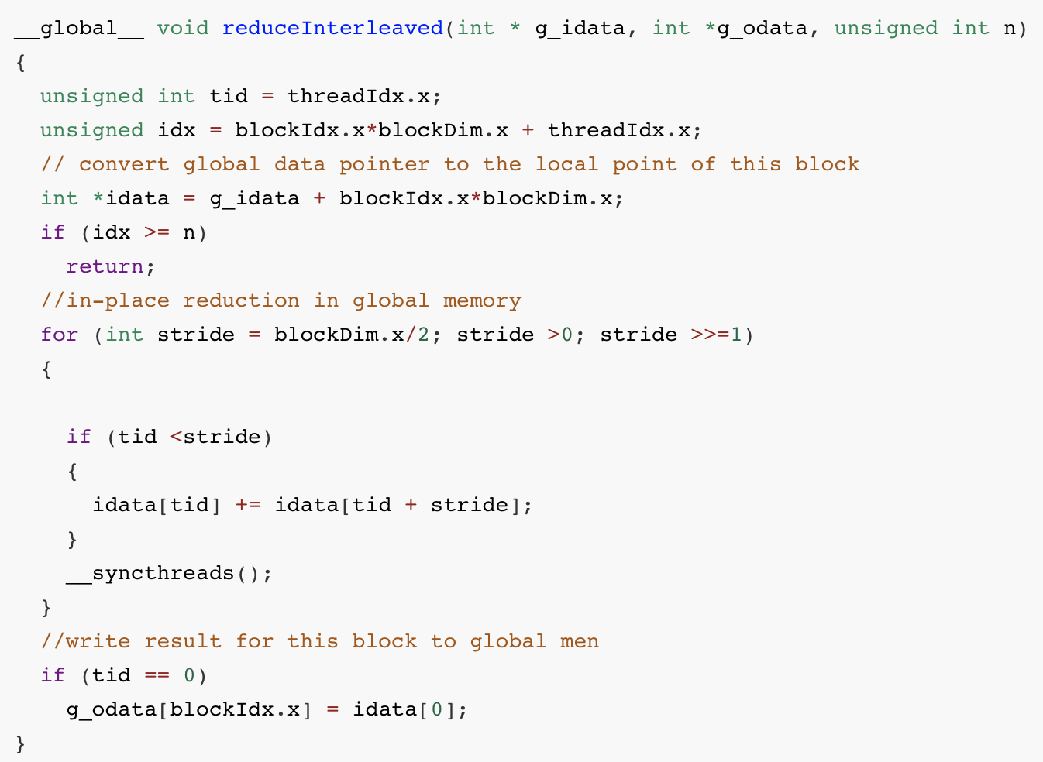
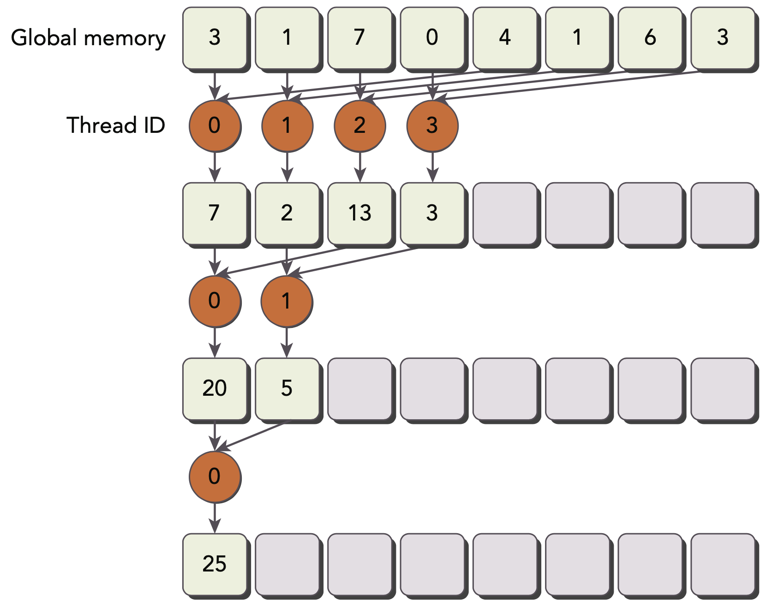
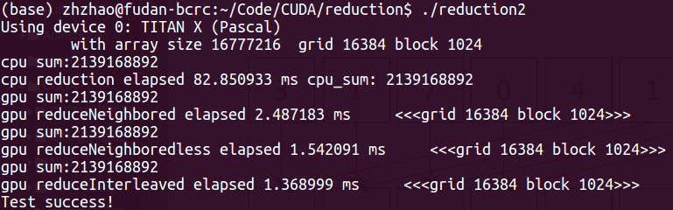
4.2 Parallel Reduction with CUDA

Slide 38
4.2 Parallel Reduction with CUDA

Slide 39
4.2 Parallel Reduction with CUDA
How to improve further?
Processing more data in one thread block.

Slide 40
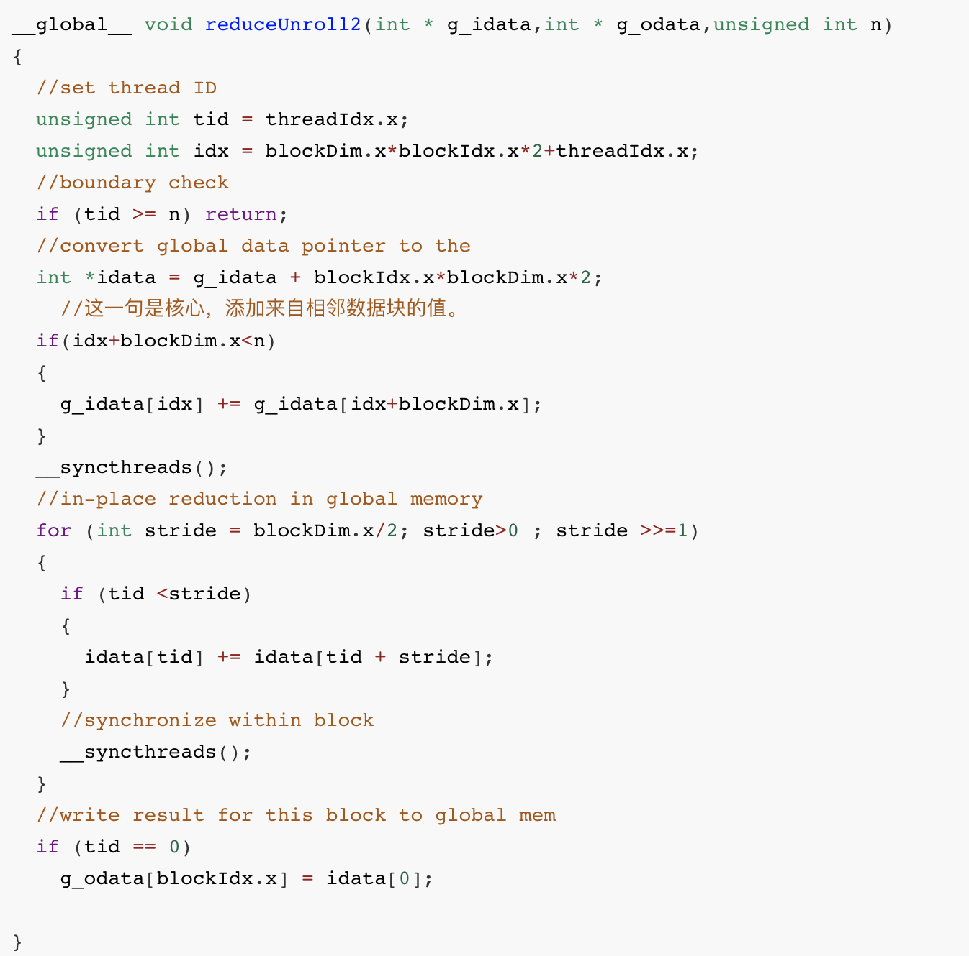
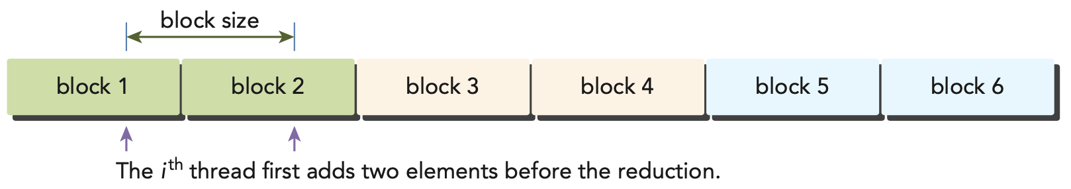
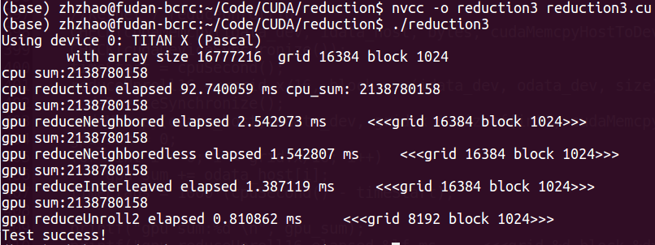
4.2 Parallel Reduction with CUDA

Slide 41
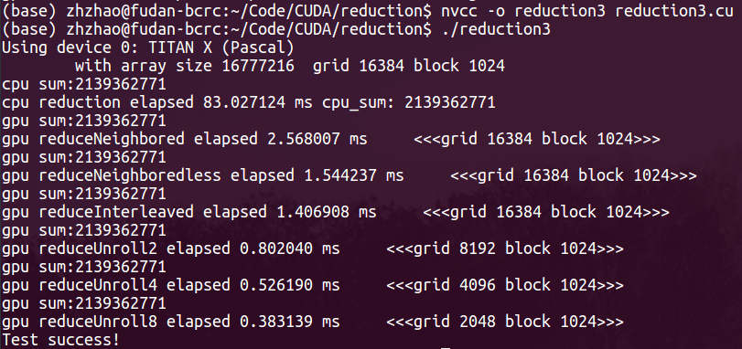
4.2 Parallel Reduction with CUDA
Adding 2/4/8 elements before the reduction.

Slide 42
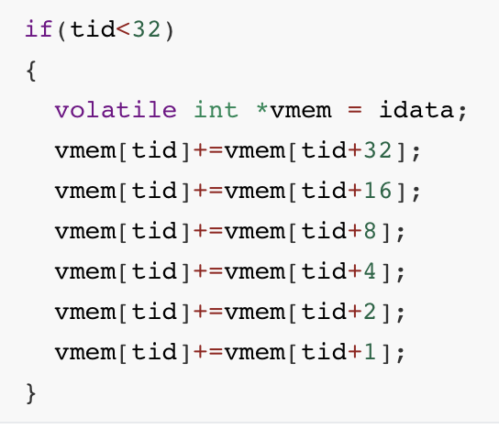
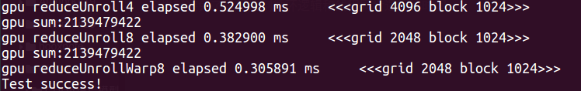
4.2 Parallel Reduction with CUDA
Speedup 2.5/0.3058 = 8.21 times

Slide 43
4.2 Parallel Reduction with CUDA
Totally Speedup 2.5/0.3058 = 8.21 times

Slide 44
5 Conclusion
CUDA Programming Model
Organizing Threads
Accessing Memory
GPU Architecture
Examples
Time<->Speedup

Slide 45
THANKS

